Slide 1


Amazon Sales
DATA ANALYSIS

Slide 2
AGENDA
To provide a comprehensive report for the given dataset, we'll analysis various aspects such as sales performance, profitability, and other relevant metrics. Here's a structured report based on the data provided
01
Overview and Summary Statistics
02
Total number of entries: 15
Unique regions: North America, Sub-Saharan Africa, Middle East and North Africa, Europe, Australia and Oceania, Central America and the Caribbean, Asia
Unique items: Personal Care, Beverages, Baby Food, Fruits, Cosmetics, Office Supplies, Clothes, Vegetables, Household, Sales Channels: Offline, Online Order, Priorities: L, C, M, H
03

Slide 3
2. Sales Analysis
Total Revenue and Total Cost
Total Revenue: $8,669,206.74
Total Cost: $6,030,927.63
Total Profit: $2,638,279.11
Revenue Breakdown by Region
North America: $1,113,207.97
Sub-Saharan Africa: $4,748,573.18
Middle East and North Africa: $6,870.28
Europe: $3,678,269.30
Australia and Oceania: $445,508.05
Central America and the Caribbean: $387,002.20
Asia: $58,471.11

Slide 4
Profitability Analysis
Most Profitable Region: Sub-Saharan Africa ($2,105,640.29)
Least Profitable Region: Middle East and North Africa ($1,748.56)

Slide 5
Sales Channel Analysis
Sales Channel Distribution:
Offline: 11 transactions
Online: 4 transactions
Revenue Comparison:
Offline: $7,596,791.19
Online: $1,072,415.55

Slide 6
. Product Category Analysis
Top Selling Categories:
Beverages: $1,535,217.88
Office Supplies: $1,956,121.49
Personal Care: $1,113,207.97
Profitability by Category:
Beverages: $532,652.54
Office Supplies: $686,706.33
Personal Care: $471,336.91

Slide 7
Time Analysis and . Order Priority Analysis
Order Date Range: 1/16/2011 - 12/29/2016
Busiest Month: March (3 transactions)
Order Priority Distribution:
High: 3 transactions
Medium: 5 transactions
Low: 7 transactions
Critical: 0 transactions

Slide 8
Conclusion
This report provides a snapshot of the sales performance, profitability, and distribution across various dimensions such as regions, sales channels, product categories, and order priorities. It highlights insights that can guide strategic decisions to improve profitability, optimize sales channels, and focus on high-performing product categories. Adjustments in marketing strategies or operational efficiencies may be considered based on the findings to enhance overall business performance.

Slide 9
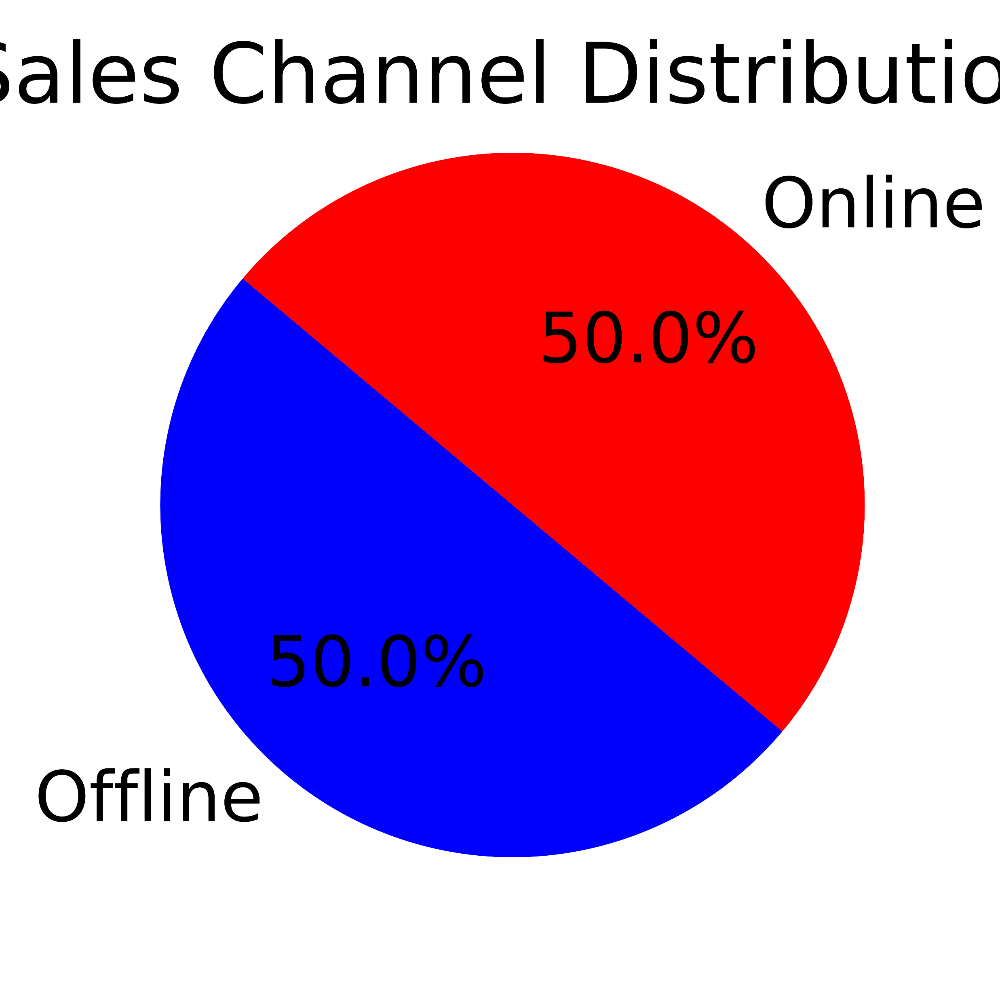
Graphical Analysis

Slide 10
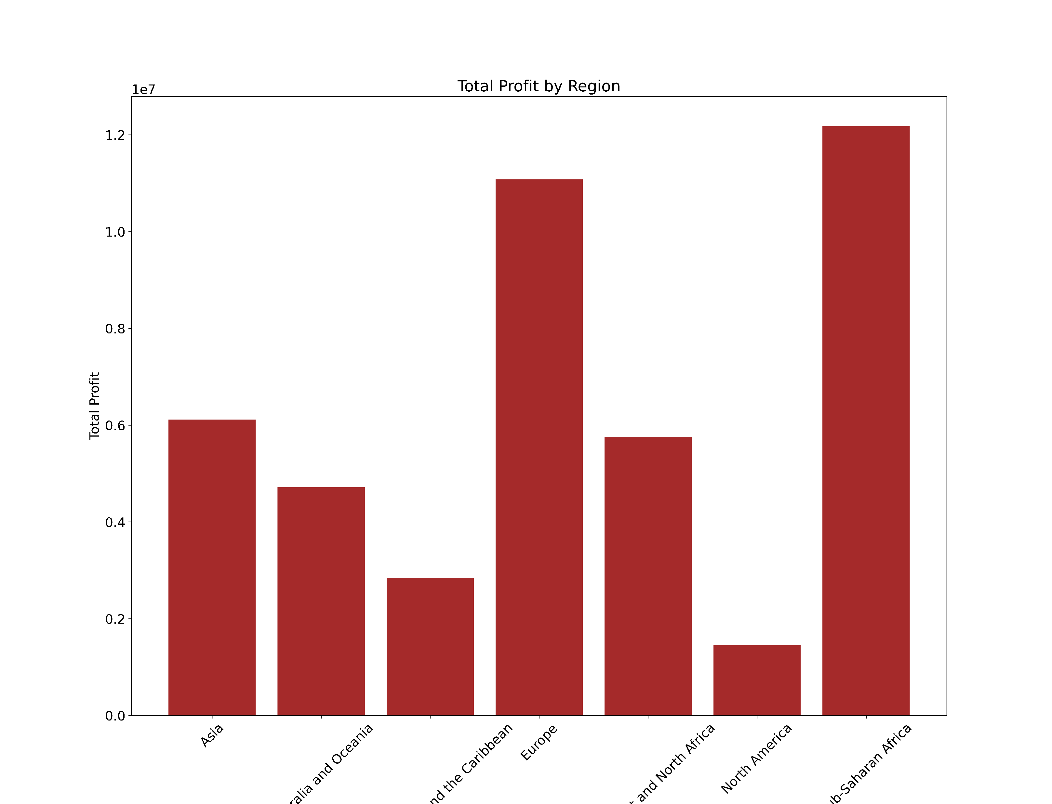

Slide 11
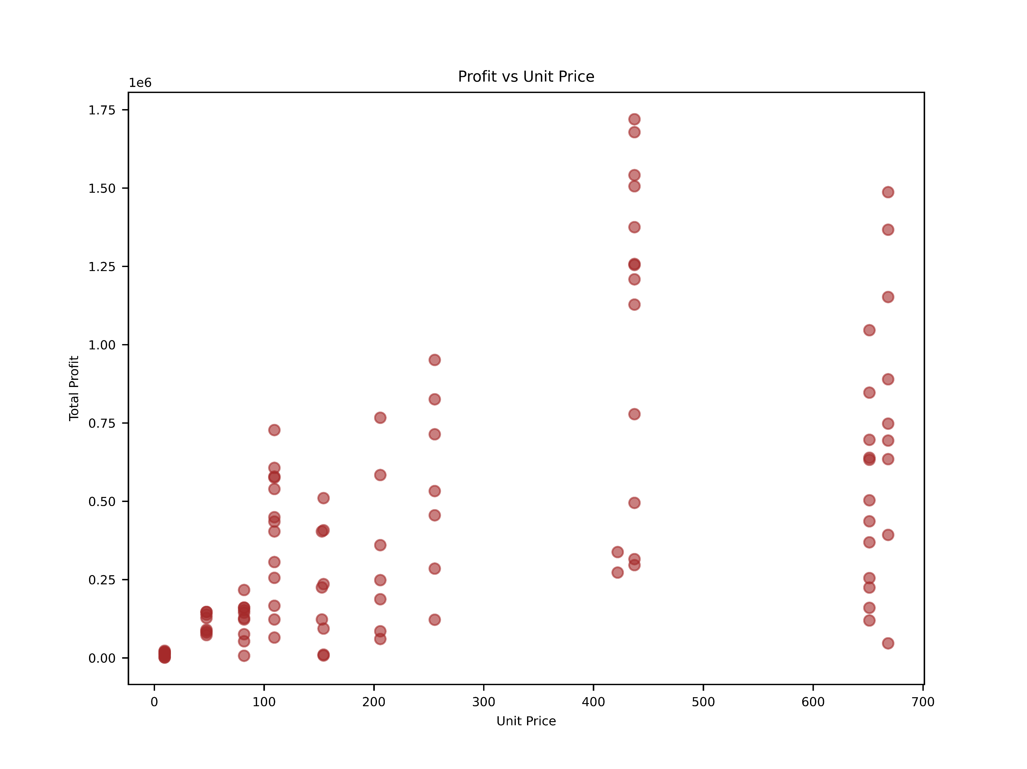

Slide 12
